Slide 1
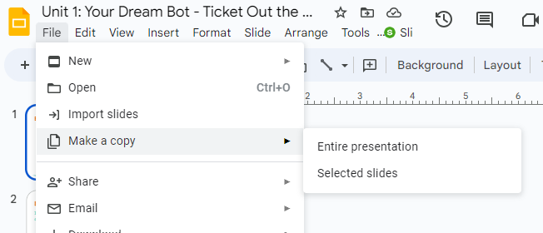
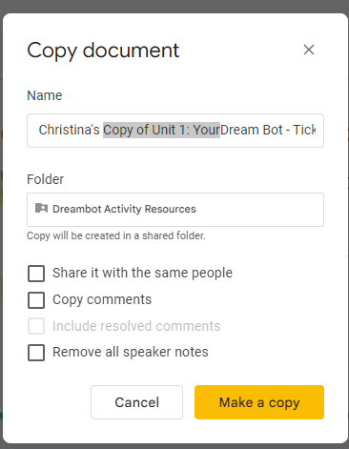
Before Editing Make a copy of this document
STEP 2
Add your name
Delete highlighted text
STEP 1: File > Make a copy > Entire Presentation
Step 3 - Click Make a copy

Slide 2

My Dream Bot
Over the course of Unit 1, you will design your own dream robot.
Developed for the AI4GA (Artificial Intelligence for Georgia) project funded by National Science Foundation awards DRL-2049029 and DRL-2048502.
This work is licensed under the Creative Commons. Attribution-NonComercial-ShareAlike 4.0 International License. https://creativecommons.org/licenses/by-nc-sa/4.0/

Slide 3
Lesson 1.2 (A): Exit Ticket
If you could have a dream robot to help with one aspect of your life, what would the robot do?
What would you name the robot?

Slide 4
Lesson 1.2 (B): Exit Ticket
Let’s make your dream robot autonomous!
What decisions can your robot make?
…
…

Slide 5
Lesson 1.3 (A): Exit Ticket
What things will your dream robot be able to sense? What kinds of sensors is it going to use?

Slide 6
Lesson 1.3 (B): Exit Ticket
What does your robot look like physically?
My robot looks like:
  Describe your robot
  Where are all of the sensors located on the robot?

Slide 7
Create Your Robot
Create options:
A labeled drawing
A description and diagram
3D model
Cardboard model

Slide 8
Lesson 1.4: Perception
My robot needs to detect …
Example:
My robot waiter uses cameras to tell where tables are so it can place food at the correct table.
Hint: Not sure what sensor to use? Try searching on the internet.

Slide 9
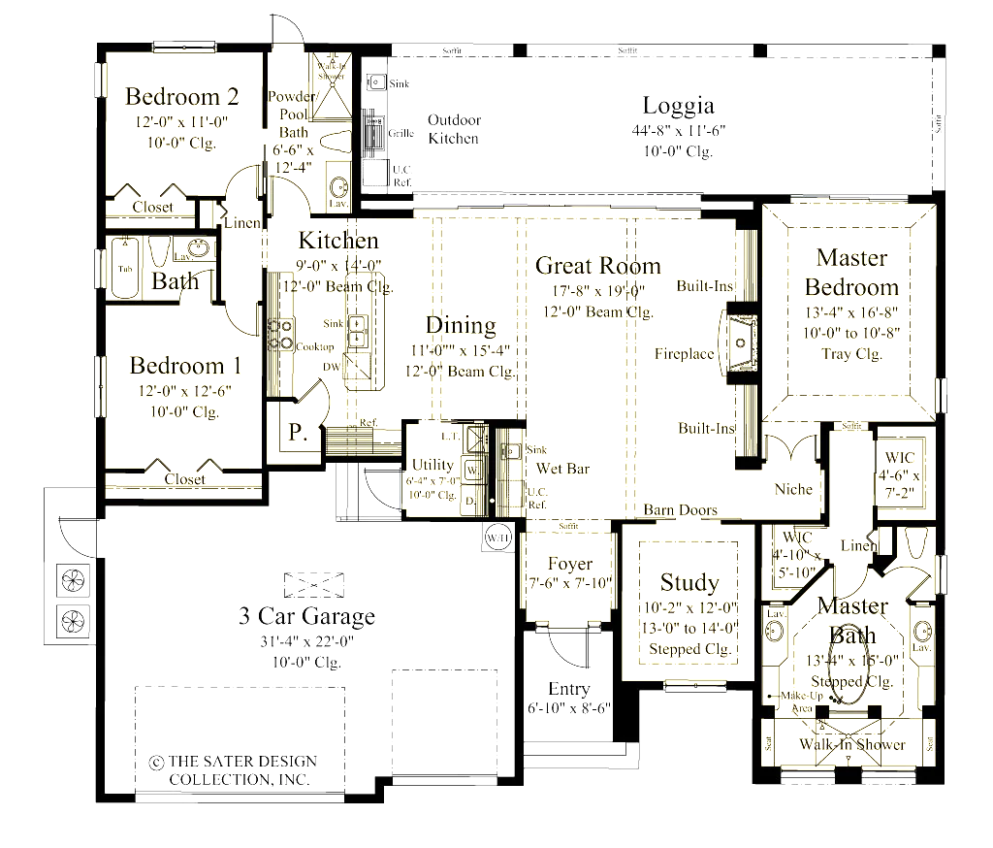
Lesson 1.5: Route Finding
Imagine you robot needs to move.
How might your robot use “route finding”? My robot will map out the house to…
What map would your robot need to know or discover?
How would your robot find the best route? (pre-determined, breadth-first, etc)
Notes:
*how to make this work with other sensors?

Slide 10
Lesson 1.6: Societal Impact
What are some concerns people might have about your robot’s impact on society?
What are some aspects of your robot (or things you could add to it) that would have positive impacts on society?
What type of work places or locations (industries) might be interested in using your robots?

